Slide 1
B Tech Integrated In Plant Training Presentation A.Y. Semester: XII
Presented by Name : Dhrumil Shreyans Shah, Roll No. C070
Organization Name : Angel Broking Private Limited(Angel One)
Industry Mentor : Shantanu Tarani Barman
Faculty Mentor : T Vijayetha
Under the guidance of : T Vijayetha

Slide 2
Roadmap
About the Organization
About the Department
About the Project/s
Description of technical tasks
Brief of new skills gained
Overall learnings
Comments and Future Plan

Slide 3
About the Organization and About the Department
Angel Broking Limited, trading under the brand name Angel One, is an Indian stockbroker firm established in 1996.The company is a member of the Bombay Stock Exchange, National Stock Exchange of India, National Commodity & Derivatives Exchange Limited and Multi Commodity Exchange of India Limited. It is a depository participant with Central Depository Services Limited (CDSL). The company's services include online stock broking, depository services, commodity trading and investment advisory services. Personal loans and insurance are also delivered by this company. In 2006, Angel Broking also started its portfolio management services, IPOs business and mutual funds distribution arm.
Corporate Planning and Strategies- Creating a strategy for meeting business goals and improving business and overall performance on the digital products (Angel One Mobile Application, Angel Spark, Trade Angel Broking Website).
Role – Business Analyst Intern (more on Data Analyst side)
Prime Responsibility - Data analytics for a product driven trading platform.
Deep dive into massive data sets to answer key business questions using MS Office, SQL, Python, Spark, Scala and other data manipulation languages. Build new reports/dashboards to enable emerging business use cases.
Partner with Data Engineering team to ensure timely up-gradation to new data technology. Present written recommendations and insights to key stakeholders that will help shape effective selection expansion strategies worldwide.
ABMA(Angel One Application for both IOS AND Android),SPARK(Angel Spark Application only on Android Version) and TAB (https://trade.angelbroking.com/)

Slide 4
Products and Services
Products
1. Equity Trading- Equity trading is the buying/selling of company shares at a market value. Equity trading is the buying and selling of company shares or stocks, also known as equities, on the financial market..
2. Commodity-A commodity trading are physicals goods that they can trade such as precious metals, energy, agriculture and base metals. Commodity trading is the buying, selling and trading of commodities. of wheat, etc.
3. Currency trading-It allows investors and traders can buy/sell international currencies. Currency trading, often referred to as foreign exchange or Forex, is the purchasing and selling of currencies in the foreign exchange marketplace, done with the objective of making profits.
4. Futures and Options
It lets you to trade in futures and options respectively. In future traders can buy/sell the underlying securities at predefined or future date. Whereas options give the rights to buy/sell underlying securities at specified date without any obligation.
5. Mutual Funds and SIP
It enables investors to pool their money into the one professionally managed investment that are mutual funds. If you want to invest money in an ideal way you can go for SIP that allows investors to invest in regular intervals.
Services
1. Demat Services-Through demat services Angel Broking is offering securities in electronic form. Demat services are one of the secure and convenient way to keep track of shares, time saving and since it holds the securities electronically there will be a no storage risk.
2. Trading Services- Like bank accounts, trading accounts acts as a platform that use to buying/selling securities. With the help of Angel Broking online trading platforms traders and investors can buy/sell stocks at one click.
3. Intraday Services- It doesn’t let you to keep your stock for 2-3 days. With the Intraday services you can sell/buy stocks within a same day hassle-free.
4. IPO Services
IPO stands for Initial Public Offering in which company’s shares are traded for the first time in Public
Whenever a company needs capital then it can be collected in two ways; bank borrowings and share capital. When a firm decides to collect money through going to the public, it comes out in the form of IPO. A client can apply in IPO either online or offline, online IPO subscription is possible through website or mobile app whereas offline IPO application can be placed through filling manual forms at any of the nearest broker’s branches.

Slide 5
Platforms of Angel Broking
Angel Broking App (mobile trading application) - Angel Broking Mobile app has launched ARQ powered auto advisory tool which completely runs on algorithms which help investors to stay invested in top-performing stocks and mutual funds. It lets the traders and investors to trade on their fingertips anywhere and everywhere in the world. It also provides financial assistance to clients so that you can invest in the right stock. Angel Broking app is a highly secured and easy-to use platform which incorporates many innovative features, faster stock trading, market analysis, real-time market coverage, advanced charting, funds transfer facility to multiple banks and much more. The app is available for free to all the clients.
Trade Angel Broking (Online trading platform) -Web-based online platform of Angel Broking is where any client can login and trade through the broker’s web platform on any of the supported browser. It is an updated version of earlier platform “Angel Eye” and can be traded at trade.angelbroking.com. One can trade in equity cash and intraday, derivatives, currency, bonds, IPO, mutual funds, futures & options, commodity and others through this platform.
Angel Bee (Mutual Fund investment app)- Angel Broking offers a special app for mutual fund investors, Angel Bee, where they can invest and track the investments in mutual funds of various categories. The app comes with the option of both the types of investments, i.e., SIP and lump-sum with other benefits such as zero paper work, tailor made recommendations, and much more.
Angel Broking ARQ (Investment advisory tool) - Angel Broking has launched an innovative investment engine, called ARQ to build efficient portfolio. ARQ comes up with multiple power including machine learning, cognitive technology, and deep industry insights. The automated advisory tool provides personalized advice to clients based on individual’s investment requirements. The tool creates, monitor and rebalance investors’ portfolio to offer them index-beating returns.
Angel Broking Smart-APIs (Build Traing and Investing Platform) -Angle Broking Smart-API offers free algorithmic trading to retail investors, advisors, startups, or essentially anyone who wants to get into the algorithmic trading game. This helps in boosting the investing power of retail investors and executes real-time trades via Angel Broking which is deployed in 5 programming languages. Therefore, Smart-API allows you to execute trades through small snippets of code in a language you are familiar with.

Slide 6
About the Projects
ABMA Projects (Tasks done in the project)- Android and iOS
Daily app metrics update -ABMA IOS
Daily app metrics update –IPO ABMA Android
Daily app metrics update –TAB
Daily app metrics update –Spark Web
Event creation (Creating Analytical Events for Stock Overview for ABMA Android and iOS)
Event creation (Creating Analytical Events for Mutual Funds for ABMA Android and iOS)
Event creation (Creating Analytical Events for Reports for ABMA Android and iOS)
Event creation Creating Analytical Events for NFO(New Fund Offering) for ABMA Android and iOS
Hamburger Menu and More section Update for Users and Clicks (Data Filling)
Spark Projects(Tasks done in the project) - Android and iOS
Event creation for Login Module for Spark (Creating Analytical Events)
Event creation for Homepage Module for Spark (Creating Analytical Events)
Event creation for Watch-list Module for Spark (Creating Analytical Events)
Event creation for Profile Module for Spark (Creating Analytical Events)
Event creation for Search Module for Spark (Creating Analytical Events)
Event creation for Buy/Sell/Option Chain/Stock Details Module for Spark (Creating Analytical Events)
Data Extraction for Testing Feedback for App Reviews for Google Play Console(Play Store)
Spark Web Projects(Tasks done in the project)
Event creation for Generic Module for Spark (Creating Analytical Events)
Event creation for Login Module for Spark (Creating Analytical Events)
Event creation for Watch-list Module for Spark (Creating Analytical Events)
Event creation for Profile Module for Spark (Creating Analytical Events)
Event creation for Search Module for Spark (Creating Analytical Events)

Slide 7
Description of Technical Tasks
Updating the daily metrics numbers for ABMA_IOS for the metrics on a daily basis also updating its weekly numbers and Monthly Numbers for trading days and non trading days
These are the following metrics
DAD-Daily unique devices launching the app
DAU-Daily unique users (KYC users) who launched the app
Guest User -Users who launched the app and are unknown as they have not logged in
First time app launch-Users who launched the app for first time after install
Sign Up (button click)-Users who clicked on the signup button on the welcome screen
Order Punched-Buy/Sell orders that are submitted from the app but execution status not confirmed from the exchange
Order Rejection-Order that gets rejected from the app at the time of placing (primarily due to insufficient fund)
Portfolio-Users who click on the Portfolio icon on the footer menu and landed on portfolio screen
Updating the daily metrics numbers for IPO ABMA Android for the metrics on a daily basis also updating its weekly numbers and Monthly Numbers for trading days and non trading days
DAU (Unique Users)
Hamburger menu visits (Unique users)
Trade menu visits(Unique users)
IPO Section Click(Trade Menu Sub option)
Investment Opportunity Visits(Unique users)
IPOs and FPOs Clicks(Unique users)
IPO list visits (Unique Users Trade Menu+Investment Opp)
Order modified (unique users)
First Time Initiated IPO (clicked on apply button)
Order Cancelled(unique users)

Slide 8
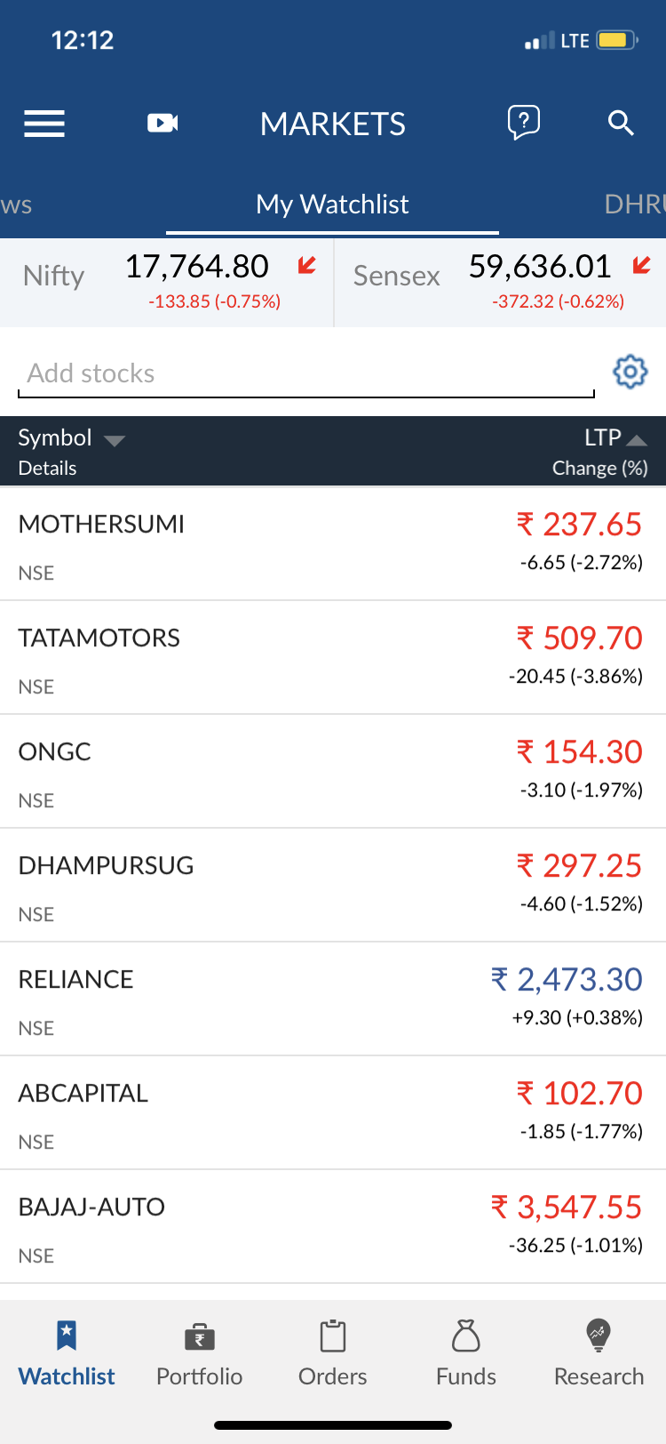
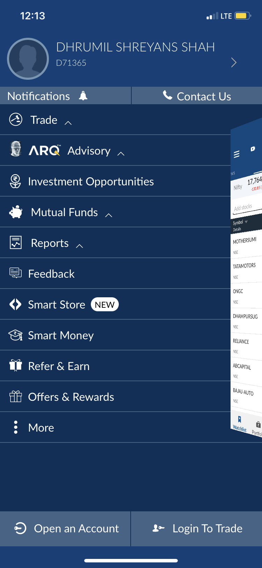
Description of Technical Tasks
Updating the daily metrics numbers for Hamburger-Menu for the metrics on a daily basis for trading days and non trading days
These are the following metrics -
Overall Users
Total Hamburger Menu Users
Trade Menu- Overall, IPO, Limits, StockSIP,
Margin Calculator, StockSIPOB
My Profile-Overall
Insta Trade-Overall
More-Overall
Logintotrade-Overall
Refer and Earn-Overall
Options Simplified-Overall

Slide 9
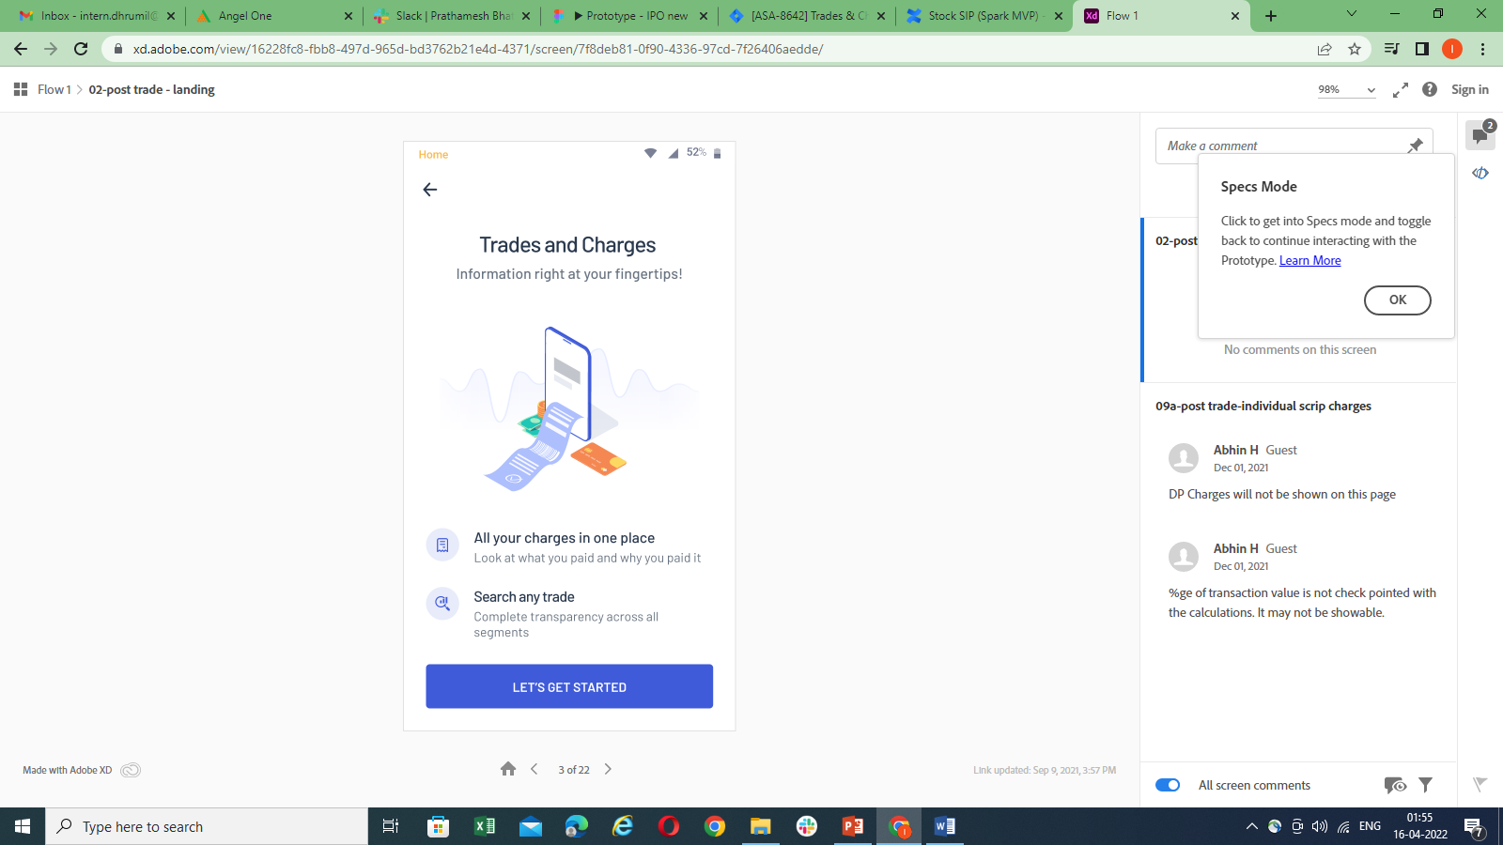
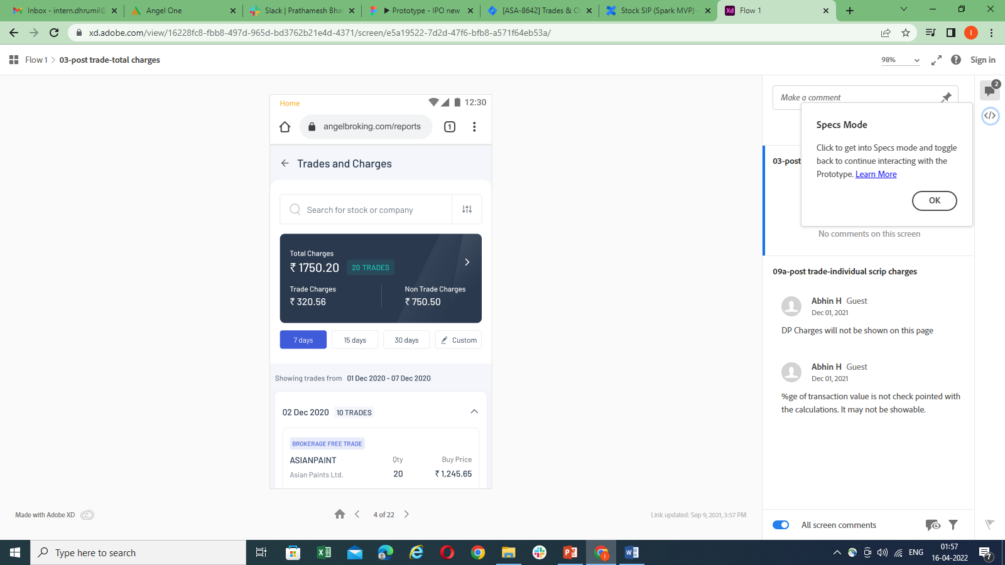
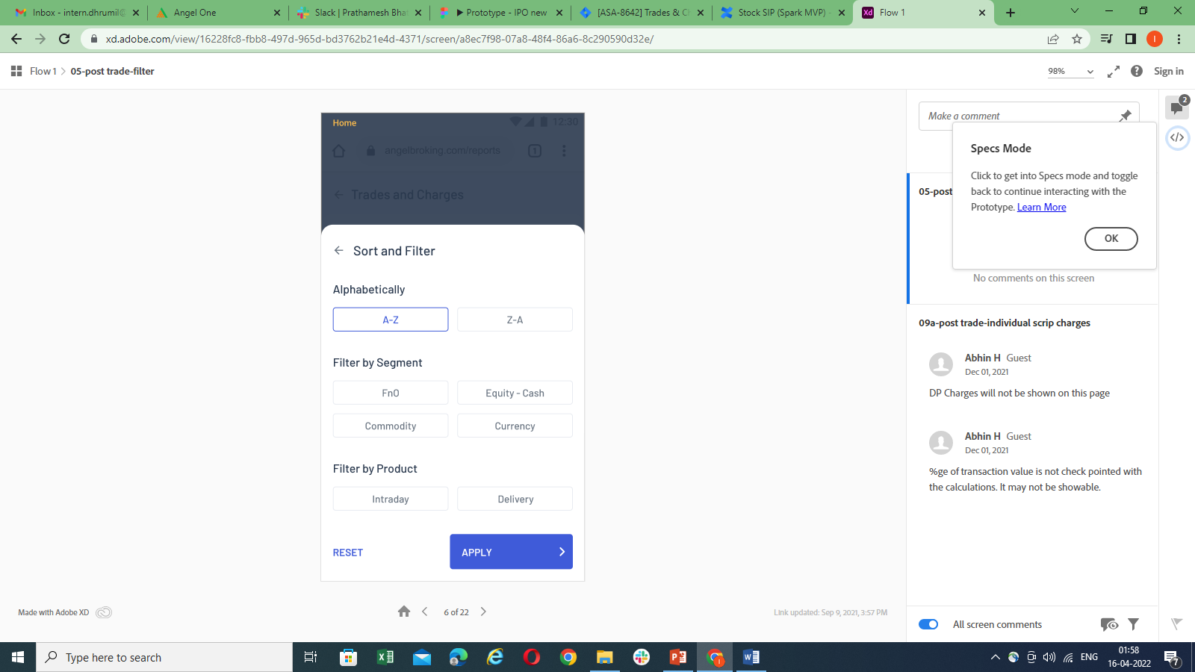
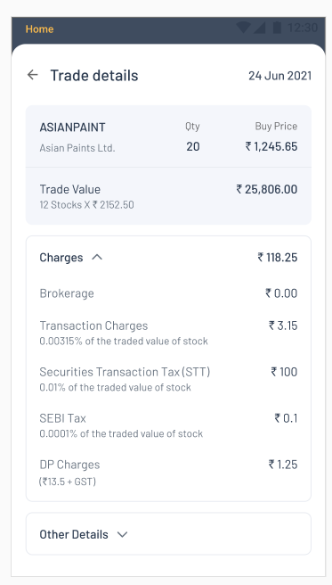
Description of Technical Tasks
1.Analytical Event Instrumentation(Creating Events)
For example- Creating the Events for Spark Android and iOS- Trade and Charges for Spark(Android and iOS) by observing the following screens/UI given below-
Screen 1 Screen 2 Screen 3 Screen 4

Slide 10
In this we are instrumenting and creating analytical events by observing the UI (User Interface/screen) of different modules for Angel One Mobile Application. While creating the analytical events we are focusing majorly on ABMA, TAB and Spark applications. While creating the events we are assuming some of the parameters by observing the screen/UI given. The parameters while creating the events used are the screen_name, event_type, event_subtype, event_name, event_id , event_metadata and event_property
In screen_name – screen name of the UI is passed as given, Event_type –impression/click/swipe/scroll is passed, event_subtype- button/icon//drop-downlist/text/search-bar/tab is passed ,event_name- event of the UI is passed and in event_metadata – other or extra information is passed and event_id where we store the events.
While creating the events the main criteria is to cover each and every scenario where the user can click on the screen.

Slide 11
screen_name | Event_type | Event_subtype | event_name | Event_id | Event_metadata
s-TradesandCharges | Impression | screen | s-TradesandCharges | 28.0.0.1.0
s-TradesandCharges | click | button | Let’sGetStarted | 28.0.0.1.1
s-TradesandCharges | click | icon | backarrow | 28.0.0.1.2
s-TradesandCharges | click | search | searchbar | 28.0.0.1.3
s-TradesandCharges | click | icon | SortandFilterby | 28.0.0.1.4
s-TradesandCharges | click | card | TotalChargesCard | 28.0.0.1.5 | {"Total Charges":"1750.20","NoofTrades":"20","TradeCharges":"320.56", "NonTradecharges":'' 750.50"}
s-TradesandCharges | click | button | DaysRangeSelection | 28.0.0.1.6 | {"DaysRangeSelected":"7 days/15 days/30 days/Custom"}
s-TradesandCharges | click | select | TradeDetailsSelection | 28.0.0.1.7 | {"stockname":"Reliance","Qty":"5","BuyPrice":"1100","SellPrice":"1200", "Exchange":"NSE/BSE"},{"action":"buy/sell"},{"ProductType":"Delivery/Intraday/..."}, {"Charges":"Rs4.78"}
bs-TradesandCharges-SortandFilter | Impression | bottomsheet | bs-TradesandCharges-SortandFilter | 28.0.0.2.0
bs-TradesandCharges-SortandFilter | click | button | sortalphabetically | 28.0.0.2.1 | {"sorttype": "A-Z/Z-A"}
bs-TradesandCharges-SortandFilter | click | button | FilterbySegment | 28.0.0.2.2 | {"FnO/Equity-Cash/Commodity/Currency"}
bs-TradesandCharges-SortandFilter | click | button | FilterbyProduct | 28.0.0.2.3 | {"Intraday/Delivery"}
bs-TradesandCharges-SortandFilter | click | text | Reset | 28.0.0.2.4
bs-TradesandCharges-SortandFilter | click | button | Apply | 28.0.0.2.5

Slide 12
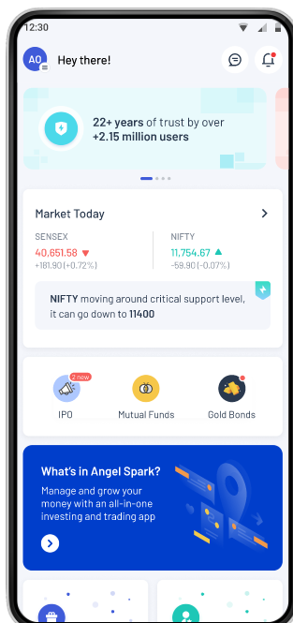
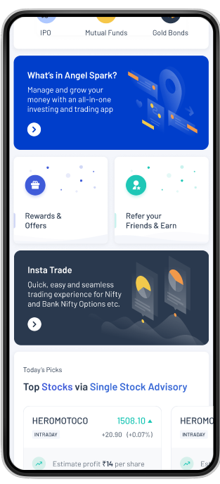
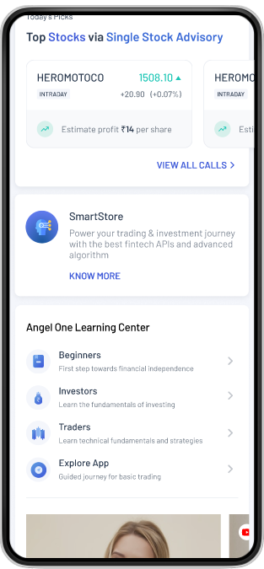
Analytical Events-Homepage

Slide 13
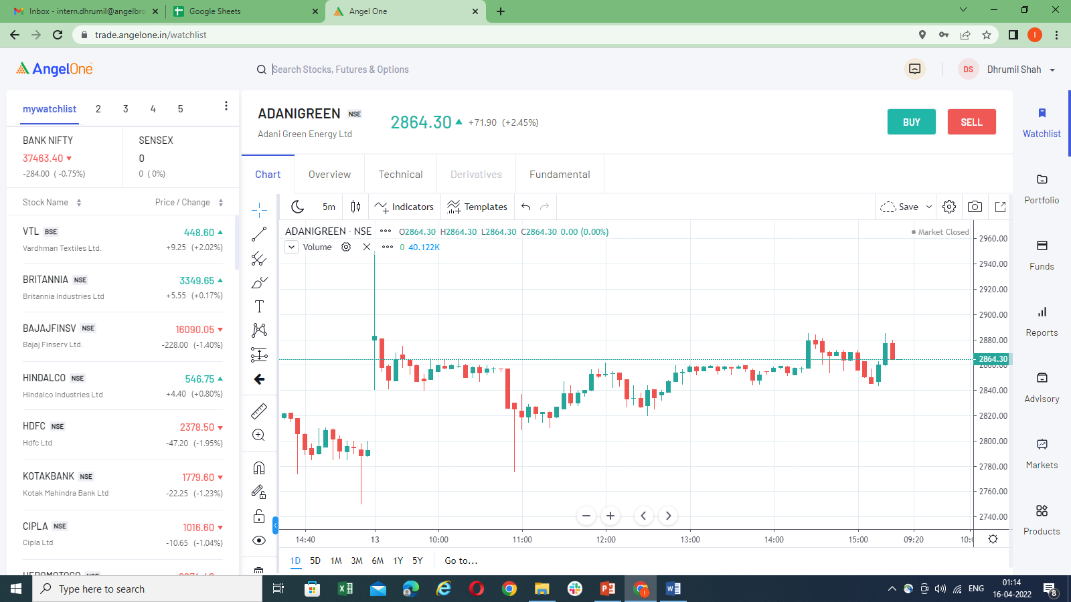
Creating Events for Spark Web(Website Events)

Slide 14
In the screenshot shared in the previous slide its an example of the platform of Spark Web(Website).While creating events we consider an impression screen of the website. On the right side of the website screen you can observe there menu clicks(Watch-list/Portfolio/Funds/Reports) so we make events taking click of that. On the top you can observe there are two button clicks (Buy/Sell) so an event is made for that. On the screen you can too observe there sort clicks too(Stock-name/Price/change) so event for that too is also made.On the screen Tab clicks are also observed(Overview/Technical/Derivatives/Fundamentals). While creating events stock-name, exchange , price, change% is also observed that is also passed in event_metadata.
2.Testing
Testing is the process of evaluating and verifying that a software product or application does what it is supposed to do. The benefits of testing include preventing bugs, reducing development costs and improving performance. In testing the main criteria for us is to test the events and check its all parameters by writing the queries to check whether those events are working properly or not. While testing we are checking whether the testing result’s is matching with the events parameters.
3.TPS(Throughput per second time) for Clicks and Users
Throughput is one of the key metrics in performance testing. It's used to check how many requests a software will be able to process per second, per minute or hour. In TPS the main criteria for us is to observe the screen/UI given for the module and to create a line chart for the given time intervals and dates for different modules as per given. While creating the TPS we are focusing on the load testing performance as we are analyzing that how many Maximum, Minimum Users and Maximum, Minimum Clicks are there for that particular screen/UI by taking out its data for Users, Clicks and Time Interval.

Slide 15
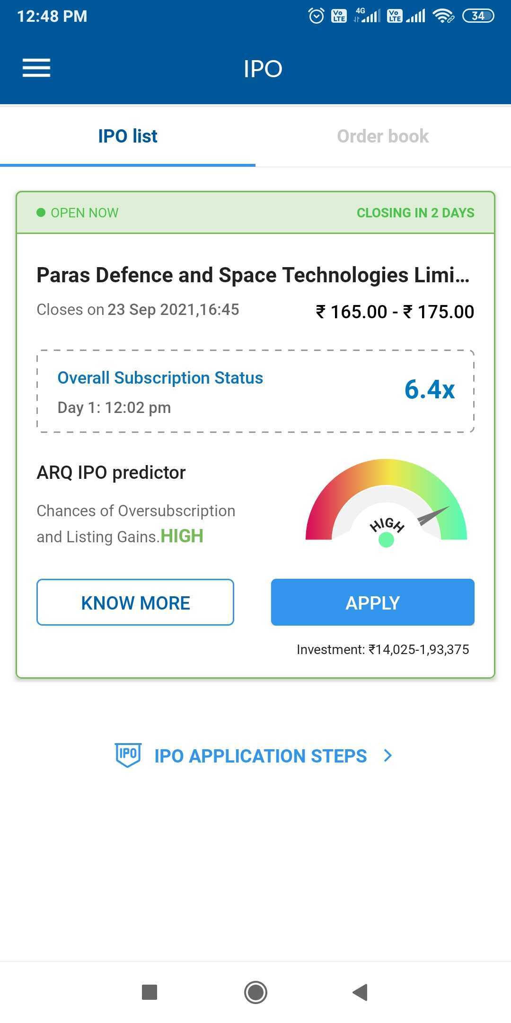
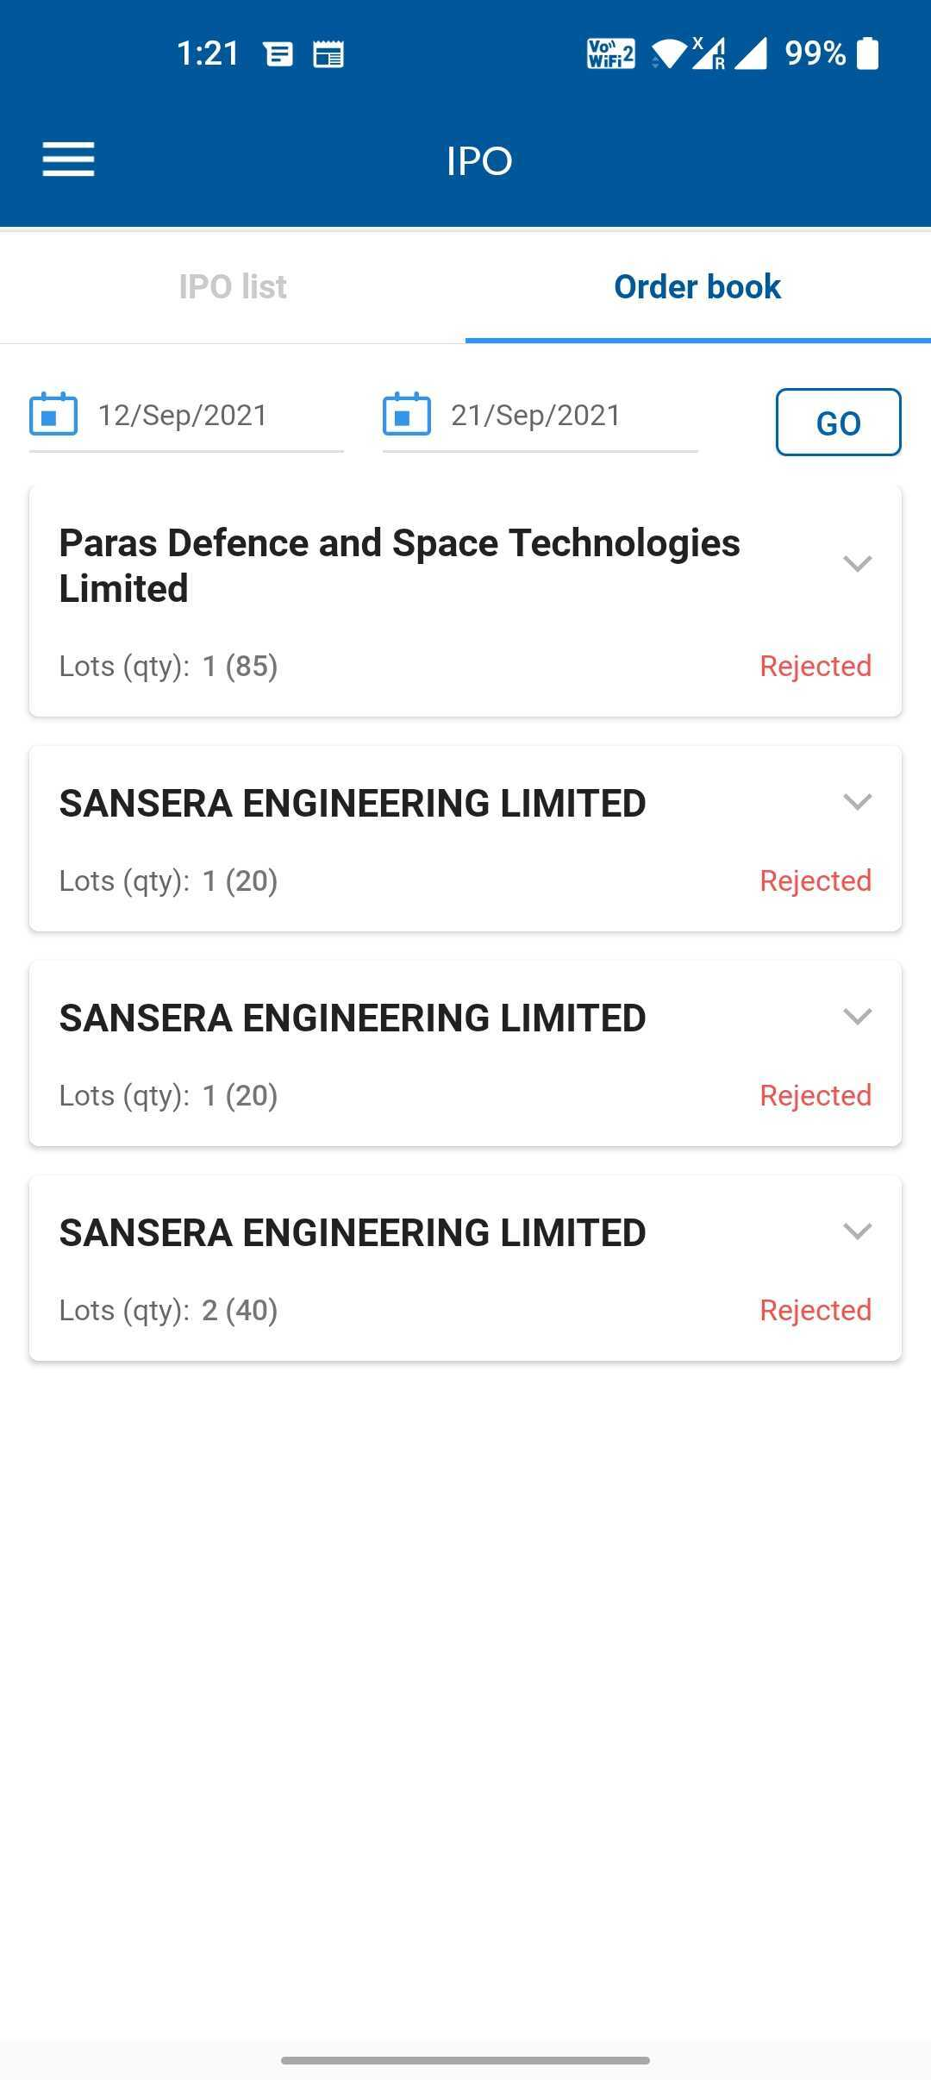
Description of Technical Tasks
For Example-Creating TPS for IPO for the particular screen/UI given below -

Slide 16
TPS and Testing Query Code
15 minute Query Code
with raw_data as( Select COUNT(app_id) as Hits, approx_distinct(client_id,0.005) as Users, date_trunc('minute',CAST(api_timestamp as timestamp) - interval '1' minute * (minute(CAST(api_timestamp as timestamp)) % 15)) as sec_time, dt from dbo_clickstream_data.dp_clickstream_abma_android where dt in ('2021-08-02','2021-08-05') and event_id = '8.6.3.0.0.0' group by 3,4) Select Avg(Hits) as AvgH, Avg(Users) as AvgU, date_format (CAST(sec_time as timestamp),'%k:%i:%s') from raw_data GROUP BY 3
1 minute Query Code
with raw_data as( Select COUNT(app_id) as Hits, approx_distinct(client_id,0.005) as Users, date_trunc('second',CAST(api_timestamp as timestamp) - interval '1' minute * (minute(CAST(api_timestamp as timestamp)) % 1)) as sec_time, dt from dbo_clickstream_data.dp_clickstream_abma_android where dt in ('2021-08-02','2021-08-05') and event_id = '8.6.3.0.0.0' group by 3,4) Select Avg(Hits) as AvgH, Avg(Users) as AvgU, date_format (CAST(sec_time as timestamp),'%k:%i:%s') from raw_data GROUP BY 3
Testing Query Code
select * from dbo_clickstream_data.dp_clickstream_uat_cug_real_time where dt='2022-04-22‘ and event_id in('5.0.0.9.31','5.0.0.9.32') and api_hr='13' and client_id='S783844‘
select * from dbo_clickstream_data.dp_clickstream_spark_android_real_time where dt='2022-03-24‘ and event_id in('7.0.0.4.7','7.0.0.2.7','7.0.0.2.8','7.0.0.41.0','7.0.0.41.3','7.0.0.42.0','7.0.0.42.1','7.0.0.45.0','7.0.0.45.1','7.0.0.45.2','7.0.0.46.0','7.0.0.46.1','7.0.0.2.10','7.0.0.47.0','7.0.0.47.1','7.0.0.47.2','7.0.0.47.3','7.0.0.6.3') and api_hr='14' and client_id='D71365'

Slide 17
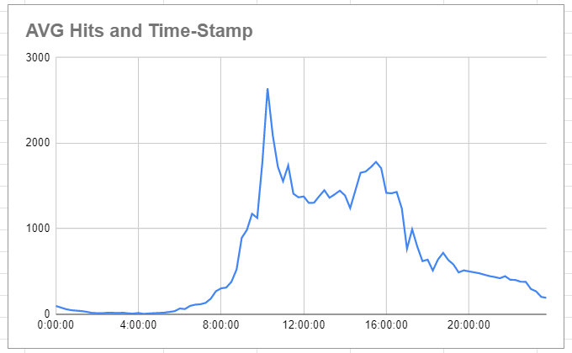
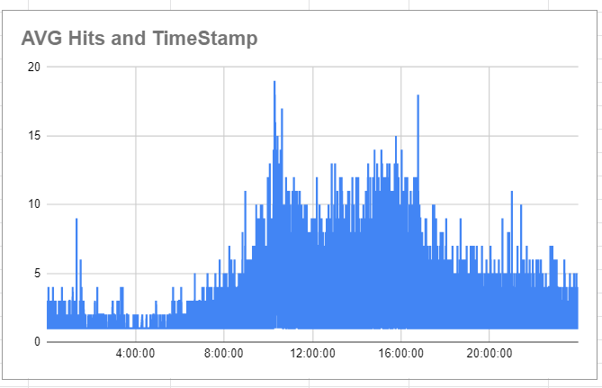
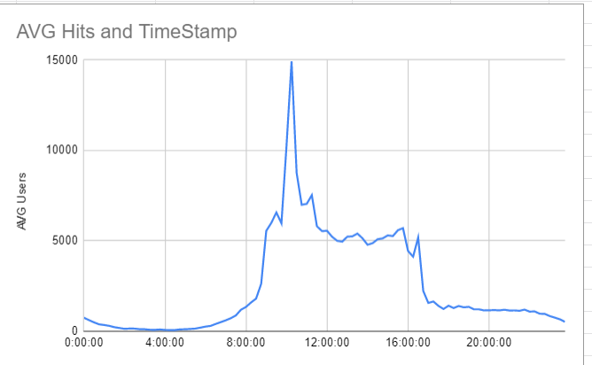
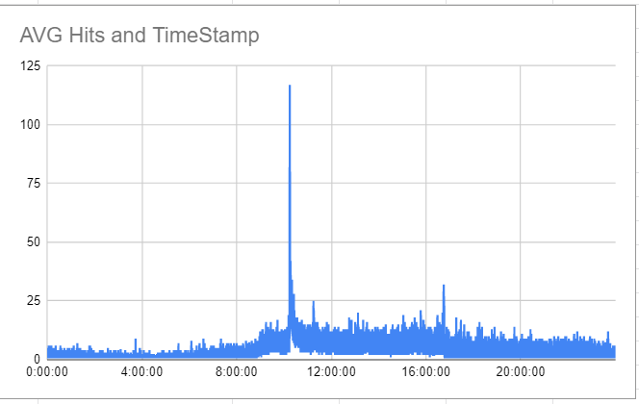
Line Charts for the TPS(IPO Order-Book and IPO-List)
Line Chart for 15 minutes Time Interval Line Chart for 1 second Time Interval

Slide 18
Brief of new skills gained
Qubole- Qubole, an Idera Inc. company, provides a simple and secure data lake platform for machine learning, streaming, and ad-hoc analytics. Qubole is a simple, open, and secure Data Lake Platform for machine learning, streaming, and ad-hoc analytics. The platform provides end-to-end services that reduce the time and effort required to run Data pipelines, Streaming Analytics, and Machine Learning workloads on any cloud.
Redash - Redash is an open source SQL-based service for analytics and dashboard visualizations. It offers a familiar SQL editor interface to browse the data schema, build queries, and view results that should be familiar to anyone who’s worked with a relational database. Queries can be easily converted into visualizations for quick insights, connected to alerts to notify on specific data events, or managed by API for automated workflows.
Jira- Jira is a proprietary issue tracking product developed by Atlassian that allows bug tracking and agile project management. Jira Software is part of a family of products designed to help teams of all types manage work. Originally, Jira was designed as a bug and issue tracker. But today, Jira has evolved into a powerful work management tool for all kinds of use cases, from requirements and test case management to agile software development.
Google sheet Excel - Google Sheets is an online spreadsheet app that lets you create and format spreadsheets and work with other people. Google Sheets is a free, web-based spreadsheet application that is provided by Google within the Google Drive service.
Confluence - Confluence is a collaboration wiki tool used to help teams to collaborate and share knowledge efficiently. With confluence, we can capture project requirements, assign tasks to specific users, and manage several calendars at once with the help of Team Calendar add-on.

Slide 19
Overall learnings and Comments and Future Plan
Learned about how to write a basic SQL Query with its advanced part too and also learned about the Presto too.
Updating and backfilling the data numbers from the queries and also learned how to extract data too from database mainly and also understand how analytics is done across various platforms, how the numbers are monitored and how they vary on a trading day and a non-trading day. Also, every new update has an impact on numbers and how the pattern of the user changes.
Creating Events and Testing the events
TPS(Throughput per second time interval for both users and clicks) making a line chart for users and clicks
Making Dashboards for the different modules.
I learnt a lot during my internship experience. In fact, I have gained a lot of experience in the past year from where I had joined.
I can conclude that as a business analyst I have to find ways to improve efficiency, reduce waste, identify and implement solutions, meet project deadlines, and accurately document the necessary requirements.
As a Business Analyst my main role is responsible for bridging the gap between IT and the business using data analytics to assess processes, determine requirements and deliver data-driven recommendations and reports to executives and stakeholders
I am very open to whatever opportunities the future may hold, especially within this company. I pride myself in being flexible and adaptable. I think the best way of Planning for the future is to make the most of the present. I applied for this internship because it is a perfect fit with my interests and skill set.
In coming months, I’d love to grow into a more senior business analyst role. It’s exciting that your company has a strong focus on hands-on experience and continued learning opportunities.

Slide 20
Thank you Questions??

